Slide 1
Map
If keys are integers in a small range,
use an array indexed by key.
What if keys are from a large range or not even integers?
e.g. ISU ID (1000,000,000 for < 40,000 people)

Slide 2
Hash Tables
A hash table is a lookup table that acts as if it had random access into
an array.
compute with a
hash function
1. Key integer (hash code)
modulo
array size
2. Hash code index of an array
array size > # entries
3. Store the key and value in a linked list (bucket) of entries
at the index. (This is called chaining.)
Buckets allow multiple values to be stored at the same index.

Slide 3
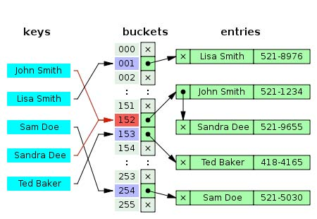
An Example from WikiPedia

Slide 4

Resolving Collisions
Collision happens when an item to be stored computes to the same
hash index as an already existing item.
• Add to the linked list stored at the hash index.
…
Sally
Jane
Steven
Jack
Hash takes time $O(1)$ on the average if
• the data is well analyzed
• the hash function and table size are set to minimize collisions.

Slide 5
Linear Probing
Look for the first open slot.
Compute the index using a hash function.
If the location with the index is empty, then insert the item.
Otherwise, look for the first open slot.
♦
Starts at the next index.
♦
Begins a sequential search at successive indices.
♦
Insert the item at the first open location.

Slide 6
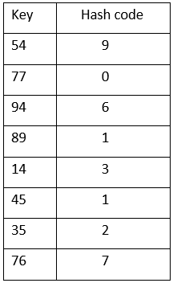
Example of Linear Probing
Hash Table
0
77
1
89
two probes
2
45
3
14
•
4
35
three probes
5
6
94
7
76
8
9
54

Slide 7
Hash Function Examples
In case we want to store
ISU student records: a hash function may return
♦ last few digits of ISU ID
♦ last few digits of SSN
♦ sum of char values on the student’s name
A list of names
♦ compute on the first 10 chars.
Vehicle info for Iowa
♦ convert letters in VIN to integers
♦ convert letters in the license plate to integers

Slide 8
Hash Function in Java
Java implementations of hash tables: HashMap or HashSet.
Every Java Object has a default hash function hashcode().
Example 1 Look up “John Smith” in a HashMap or HashSet:
Calls the built-in hashcode().
Takes a modulus of the hash code to find the bucket.
Searches the list for an entry whose key is equal to
“John Smith”, using equals().
Example 2 HashMapDemo.java

Slide 9
Rules on Hash Code
1. Equal keys must have the same hash code.
2. If you override equals(), you must also override hashcode().
It is highly desirable that if two keys are not equal, they have
different hash codes.
Each bucket has length 1 (ideally) $O(1)$ look up time.

Slide 10
Good Hash Function
$♦$Deterministic – equal keys should produce the same value.
$♦$Efficient to compute
$♦$Uniformly distributing keys
Bad examples:
♠ Sum up ASCII values of the characters – high chance for collisions
♠ Use first three letters – words starting with some three-letter
combinations are far frequent than others.

Slide 11
How to Write a Good Hash Function?
A good hash function will produce a value that incorporates all the data in the key.
Example
int result = some nonzero value
for each instance variable v used in equals()
let c be an integer hashcode for v
result = result * 31 + c
return result
prime number

Slide 12
Hash Code of a Variable
If v is
an object, then c == v.hashcode().
short, char, or byte: Set c = (int) v
boolean: Set c = (v ? 0 : 1). i.e.; if v is true, c is 0, else it is 1.
float: Set c = Float.floatToIntBits(v).
long: Set c = (int)(v ^ (v >>> 32)). (This does the XOR of the lower 32 bits with the upper 32 bits.)
float: Set long x = Double.doubleToLongBits(v);
c = (int)(x ^(x >>> 32)).
Notes:
Explain what XOR is.

Slide 13
Hash Code of an Array
Apply the same rules to the individual elements in the array.
// hash code for String works like this
if (s.length() == 0)
return 0;
int result = s.charAt(0);
for (int i = 1; i < s.length(); ++i)
{
result = result * 31 + s.charAt(i);
}
return result;

Slide 14
Choice of Hash Function
Should distribute keys uniformly into slots.
Should not be affected by any patterns in the data.
Ex. Suppose keys are in the range [0,9999], and there are 100 slots.
Consider the hash function: $h(k) = k \% 100$
If you are given numbers that are all multiples of 100 to hash,
they will all end up in the same slot 0!

Slide 15

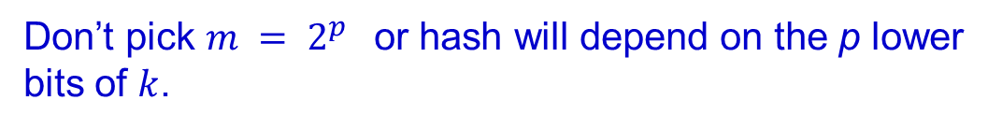
Hash Function – Division Method
$$h(k) = k \% m$$
Fast!
Don’t pick $m = 2^{p}$or hash will depend on the p lower
bits of $k$.
Pick $m$ as a prime not too close to a power of 2.
integer divisible only
by 1 and itself
Ex. 2000 character strings.
8
$h$(“pt”) = (112 • 2 + 116 ) % 1277 = 694
‘p’ in
ASCII
8 bits
per char
‘t’ in
ASCII

Slide 16

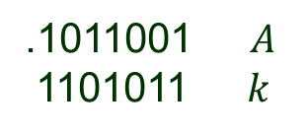




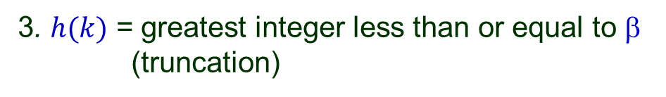


Multiplication Method
Choose a constant $A$with $0 < A < 1$but close to 0 or 1.
Choose $m$ as some power of 2.
For a key $k$, hashing in three steps:
1. $$ = the fractional part of $kA$.
2. $ = m$(left shifting)
3. $h(k)$ = greatest integer less than or equal to $$
(truncation)
Ex. $m = 8$and 7-bit words.
Binary:
.1011001 $A$
1101011 $k$
1. Take the fractional part,
2. Discard the rest.
3. Shift it to the left.
4. Take the shifted out bits.
1001010.0110011 $kA$
$$h(k)$$

Slide 17

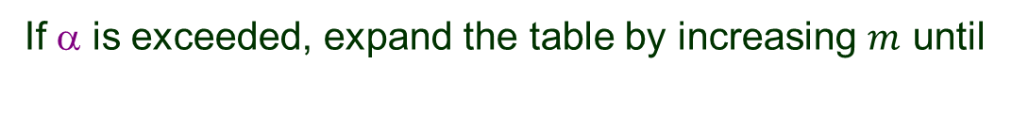
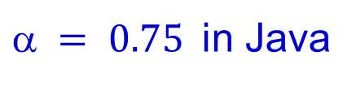
Load Factor
$m$ buckets $n$ entries
Rehash the table when it gets too full, more specifically, when
load factor
$ = 0.75$in Java
If $$ is exceeded, expand the table by increasing $m$ until
A higher load factor decreases the space overhead, but increases
the lookup time.

Slide 18















Operations on Hash Table
hash table $T$
Space of keys:
$$l$$
$$q$$
$$p$$
$$r$$
…
$$k$$
$$q$$
$$r$$
NIL
$$h(k)$$
$$L$$
hash function $h$
Insertion $O(1)$
Search $O(L)$
$O(L)$ if singly linked list
Deletion
$O(1)$ if doubly linked list

Slide 19


Worst Case
$n \text{keys} m$ buckets
Worst case: all keys hash to the same slot.
Search requires $O(n)$ time.

Slide 20





Simple Uniform Hashing
Every key $k$ is equally likely to be hashed to any bucket.
$$T[h(k)]$$
…
average size $n/m$
Time cost of unsuccessful search: $O(1+n/m)$
• $O(1)$ for computing $h(k)$ and accessing $T[h(k)].$
• Average time $n/m$to search to the end of one of the lists.
Time cost of successful search?
$$O(1+n /(2m)) =O(1+n/m)$$
• $O(1)$ to access the list.
• $O(n /(2m))$ to search the list.

Slide 21








Time Complexities
$n$ keys
$m$ buckets
put()
get()
remove()
Iterating over
the collection
containsKey()
List
$$O(n)$$
$$O(n)$$
Balanced BST
$$O(\log{n})$$
$$O(n)$$
Hash Table
HashMap
$$O(n/m)$$
$$O(n+m)$$

Slide 22
Summary on Hash Tables
Better than sequential search even when the data is not sorted.
Require analysis of data characteristics beforehand.
Require (possibly) more memory space.
A hash table stores and retrieves data item using a
hash function: data item → a positive integer
address for storage
A perfect hash function produces a unique integer for every item.
But it may be too slow to compute.
So we often settle for less than perfect hash functions.

